Slide 1
Gittin’ * DONE
a guide to using Git and GitHub for collaborative data science
by Matt Tranquada

Slide 2
Outline
(Re)Understanding Git
Git Workflow Patterns
Advanced Git and GitHub Practices
GitHub Tips for Data Science
Links and Resources

Slide 3
1. (RE)Understanding Git
A Deep dive

Slide 4
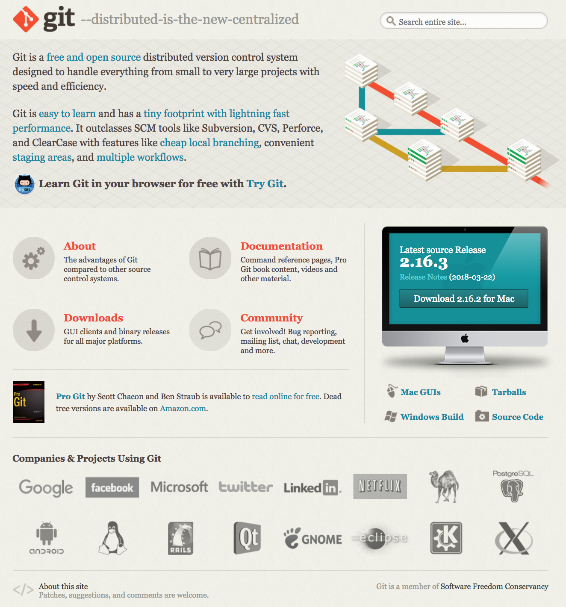
What is git?
Git is a version control system (VCS) for source code management (SCM)
The development of Git was started by Linus Torvalds after the relationship between the Linux community and BitKeeper, their VCS vendor, brokedown and it was first released in 2005
Git is a distributed version control system (DVCS) designed to scale for large and complex projects, in contrast to a centralized version control system (CVCS)
The Git-SCM homepage

Slide 5
WHAT IS SPECIAL ABOUT GIT?
Seeing the problems with existing VCS/SCM solutions available, Torvalds and company focused on a few key objectives in designing Git:
Speed – most operations in Git are performed locally and scale well with data size and complexity
Simple design – designed to be easy to adapt for a wide range of uses
Strong support for non-linear development – can support thousands of parallel development branches
Fully distributed – remote and local repositories are functionally the same, eliminating the single point of failure often found in CVCSs
Can handle large projects efficiently – designed to handle projects like linux kernel development with millions of files while maintaining speed and data integrity

Slide 6
Keys to understanding git
Git was developed as a response to all the problems Linus Torvalds saw with previous VCS and SCM systems
If you know anything about Linus Torvalds, you know he is not shy about having opinions
Although the high-level design of Git is designed to be easy to use, Git is built on top of a very sophisticated set of low-level filesystem-like tools
These are often referred to as “porcelain” (high-level) vs. “plumbing” (low-level) functions
If you get stuck, there are a lot of guides and tutorials

Slide 7
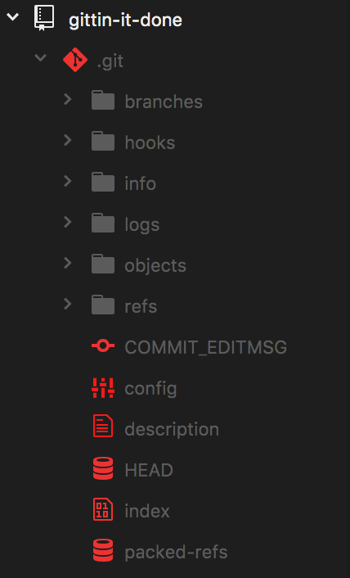
How does git actually work?
When you clone or initialize a Git repository in a directory, it actually creates a new “.git” subdirectory within the folder that stores the repo’s database
To inspect the .git directory, you can check it out on the command line or, like I do here, use a text editor like Atom to navigate it
Documents are stored as blob objects within a database and referred to by snapshots that capture the history of the project and the relationship and state of those objects along with commit messages from the contributors involved
The .git subdirectory as it appears in Atom

Slide 8
ANATOMY OF A GIT
Important Git files in the root directory:
config : Contains configuration settings for the repo, such as core settings and where remotes live.
FETCH_HEAD : Contains the hashes for branch/remote heads updated during the last git fetch.
HEAD : The current reference (“ref”) you’re looking at. (Typically the same as refs/heads/master).
index : Stores the staging area information for file edits, which includes metadata such as timestamps, file names, and hashes for files already tracked by Git.
Other Git files in the root directory:
COMMIT_EDITMSG : The message form the last commit. (Not actually used by Git!)
description : Descriptive info on repo (only used by GitWeb or git instaweb)
packed-refs : File used for storing dormant refs (/refs directory contains the actual references).
ORIG_HEAD : When doing a merge, this is the hash of the branch you’re merging into.
MERGE_HEAD : When doing a merge, this is the hash of the branch you’re merging from.
MERGE_MODE : Tracks constraints originally passed from git merge to pass to git commit in the event of a conflict.
MERGE_MSG : Lists conflicts that happen during your current merge.
RENAMED-REF : Not much documentation, but seems to be an error file related to refs.

Slide 9
ANATOMY OF A GIT
Git Directories:
branches : Directory containing information on project branches
hooks : Directory containing scripts executed at certain times when working with Git, such as after a commit.
info : Contains the exclude file, which can be used as a project-level file blacklist similar to .gitignore files
logs : Contains the history for different project branches.
objects : Git’s internal storage for blob data, with objects indexed by hash
rebase-apply : Directory used for rebasing and the git am command.
refs : Master copy of all refs that live in your repository including refs for stashes

Slide 10
Git CONCEPTS: BLOBS, Hashes, and Trees
At the core of Git is a key-value data store that allows you to put any kind of content into Git and get back a unique key to retrieve that content again
It may help to think of this like a coat check – each object that goes into the data store gets a unique ticket to pick it up, but there is no distinction about the kind of coat, the owner, etc.
Every time an object is added to the Git object data store it generates a 40-character checksum hash of the content you store (plus a header) called the SHA-1 hash
The first 2 characters of the hash will be used to name a subdirectory in the /objects folder, and the other 38 characters are used to name the blob file within
A blob is a kind of data object that only contains content without any filename
To track the filenames and relationships between files, Git has a second kind of object called a tree – each tree contains one or more tree entries containing an SHA-1 + mode, type, and filename
Blobs in a Tree

Slide 11
Git CONCEPTS: BLOBS, Hashes, and Trees
Shortened SHA-1 hash pointer
Filename
Example Description
A diagram of a Git Tree object

Slide 12
GIT CONCEPTS: Four File States
With respect to the files as you see them in the working directory of your local repository, Git sees them as being in one of four states:
Untracked : Git isn’t tracking the file so it won’t monitor any changes
Unmodified : Git has recorded the current state of the file in a previous commit already
Modified : A file has been edited, but the changes have not been staged yet
Staged : Changes are packaged up as a “snapshot” and ready to be recorded in the Git data store
Once a commit has been submitted, the included files in the working directory revert to the unmodified state
The four file states within Git

Slide 13
GIT CONCEPTS: Three GIT States, three Working Sections
Git has three main states that your files can be in:
Modified : A file has been changed, but those changes have not yet been recorded in the local database.
Staged : A modified file, in its current version, has been marked for inclusion in the next commit “snapshot”.
Committed : The data from a file has been safely stored in the local database.
These three states align with the three main sections of a Git project:
Working Directory : A single ”checkout” of one version of the project that is decompressed from the Git database and placed on disk.
Staging Area [index] : The place where
Repository [.git directory] : The place where Git stores the (zlib compressed) object database and metadata for the project. Copied when you use git clone
The three sections of the Git framework, which (from left) match the “Modified”, “Staged”, and “Committed” states

Slide 14
GIT CONCEPTS: SNAPSHOTS
Delta-Based version control
Snapshot-based version control
Records all changes as diffs/deltas relative to the original file
Only keeps track of file changes; no new data added to database if there are no changes
Space efficient to store new data, but may be difficult to recover an exact arbitrary state
Records each commit like a “snapshot of a miniature filesystem”
Each snapshot is actually a tree object!
Objects are stored using delta compression (zlib) to save space

Slide 15
GIT CONCEPTS: COMMITS
Git has a third kind of object: the commit
The structure of a commit is simple and contains:
The top-level tree for the snapshot of the project at the current point
The author and committer information
user.name
user.email
timestamp
A blank line
The commit message
Each commit references the previous commit, creating a cascading history of changes
A diagram of a single Commit

Slide 16
Blob
Commit
Tree

Slide 17
A simple graph diagram unpacking the Commit pointers in a small repository with three Commits

Slide 18
When you run git add and git commit You are
Storing blob objects for the files that have changed
Updating the index file
Writing out the snapshots as tree objects
Writing a commit that references the top-level tree object and the previous commit object

Slide 19
Git Concepts: References, branches and Heads
Instead of forcing you to remember SHA-1 hashes for each object, Git stores hashes your are tracking as references in the /refs folder
Branches in Git are simply references to different commit objects within the repository database, and the current state of each branch is tracked by a head reference
Git knows which branch you’re on by tracking the reference to your last commit in the HEAD file located in the root .git directory
An update of the example repository diagram showing the Heads of two Branches: Master and Test

Slide 20
Unpacking: initializing Git
git init
git add .
git commit
Creates a new .git subdirectory within the current directory
Adds all the files in the current directory as blob and tree objects into the .git data store
Creates a new commit object wrapping the tree and blob objects and sets the project HEAD to point to that commit reference

Slide 21
Git CONCEPTS: Tags and Remotes
Git has one more kind of object: the tag.
Tag objects are like a commit object (they contain a tagger, a timestamp, a message, and a pointer) but a tag points to a commit instead of a tree.
The tag is basically a branch reference that never moves, it just points to a specific commit and gives it a friendlier name
Lightweight tags are just stored as references, but annotated tags are full-fledged objects
There is also a third kind of reference: the remote reference.
Remote references are created to store the state of a remote repository the last time you pushed files to it
Remote references are like branch references except they are considered read-only; you can checkout from a remote ref but Git won’t point the HEAD file at it because it is only a bookmark storing the last known state and you can’t commit directly to it

Slide 22
GIT CONCEPTS: Local and Remote Repositories
Git has a special set of transfer protocols to move data between local and remote repositories
Remember, the Git model is fully-distributed, so all copies of a project repository are functionally equal except for the state – if the repo on GitHub is lost, any developer’s local repo can be used to rebuild the project
When uploading and downloading files between local and remote repositories, Git quickly compares the files on each side and sends a compressed packfile of any objects that differ based on the operation
git fetch downloads data and git push uploads data
git pull actually fetches the remote data when called, and then merges the remote branch into the current working branch, provided you are tracking a remote branch
git clone automatically fetches data from a remote repo and syncs the local master branch to track the remote master branch (origin refers to the clone source by default)

Slide 23
Unpacking: Cloning and editing a GitHub Repo
git clone
git add .
git commit
git push origin master
Git uses fetch to grab a copy of the GitHub repo, unpacks a copy of the working directory based on the origin master head state, and updates the local master HEAD to point to the same commit
Git stages all your local changes
Git commits your changes to your local repo
Git compares the local and remote repo states and then decides a) what files are different and b) are there any conflicts based on the head state of the current branch

Slide 24
Git CONCEPTS: MERGING
Merging involves taking two or more “branches” and creating a merge commit that reconciles their commit histories
Remember, a branch is just a reference to a commit in the Git model, so if you are syncing local and remote repos for a project and there is a conflict that requires a merge to resolve, Git will treat the two differing master branches like any other branches and try to reconcile the commits
Merge commits differ from normal commits in that they point to two or more parent commits
If two branches have diverged from a common ancestor, Git automatically figures out the best point to merge them from
If the branches can’t be reconciled (for example, if both branches edited the same piece of code in different ways), Git raises a merge conflict
Setting two branches up for a merge
The graph of commits after the merge commit is added

Slide 25
Merging Two Branches to Master
Before Merging
After Merging

Slide 26
UNPACKING: The PULL AND PUSH
git pull origin master
git add .
git commit
git push origin master
Git uses fetch to return the current state of the remote origin master repo, then merges it with the current state of the local working directory (i.e. the local master branch)
Git restages your changes based on the merged commits, trees, and blobs
Git writes a commit referencing the previous (new) merge commit
Git re-pushes your changes to the remote repo, which now has a common commit reference to merge the data with respect to

Slide 27
UNPACKING: MERGE AND MERGE CONFLICT RESOLUTION
git merge feature
CONFLICT (content): Merge conflict in index.html
git status
git mergetool
git add index.html
git commit
Git attempts to merge the feature branch into the current branch; you get an error; Git aborts
status will have Git show the conflicts that aborted the merge under “unmerged”
Git will open a graphical tool to help you inspect what file diffs caused the merge conflict
After editing the conflicting file(s), you use add to finish restaging the merge
Git finishes writing the aborted merge commit (git merge --abort will cancel the merge process and revert to your last commit state – beware of unstashed/uncommitted changes!)

Slide 28
Customizing Git: The CONFIG and .gitCONFIG FILE
Git looks for configuration info in multiple places:
<git app>/etc/gitconfig (system-level config info)
<user>/.gitconfig (global-level config info)
<repo>/.git/config (the local-level .git repository)
[user] section stores critical values email and name used to track author/committer
These values should be set in the .gitconfig file preferably
The user.email and user.name values are important for generating unique hashes for commits
[core] section stores basic runtime variables used by Git
The config file also tracks all remote and branch settings used by your repository
Want to change or add the aliases or links you’re using for your remotes or branches? Do it here! Just be careful if branches are being worked on under different names by other people…

Slide 29
Customizing git: The .gitignore FILE
Git also looks for ignore info in multiple places:
<global config> [core].excludesfile (global-level)
<repo>/info/exclude (local-level)
<repo>/.gitignore (directory-level)
You can use multiple .gitignore files in a single repo.
Each .gitignore applies to the directory it is in and all subdirectories additively – if you want to only exclude certain files within a subdirectory, place the .gitignore in that subdirectory
The Linux kernel repo supposedly has 206 .gitignore files
Basic .gitignore pattern matching rules:
Blank lines or lines starting with # are ignored.
Standard glob patterns (similar to regex) work, and will be applied recursively throughout the entire working tree (i.e. applied to all subdirectories of this directory)
You can start patterns with a forward slash (/) to avoid recursivity.
You can end patterns with a forward slash (/) to specify a directory.
You can negate a pattern by starting it with an exclamation point (!).
You can specify a global default file to use by setting the [core].excludesfile option

Slide 30
Customizing Git: .gitignore Syntax Examples
# ignore all .a files
*.a
# but do track lib.a, even though you're ignoring .a files above
!lib.a
# only ignore the TODO file in the current directory, not subdir/TODO
/TODO
# ignore all files in the build/ directory
build/
# ignore doc/notes.txt, but not doc/server/arch.txt
doc/*.txt
# ignore all .pdf files in the doc/ directory and any of its subdirectories
doc/**/*.pdf
https://git-scm.com/book/en/v2/Git-Basics-Recording-Changes-to-the-Repository

Slide 31
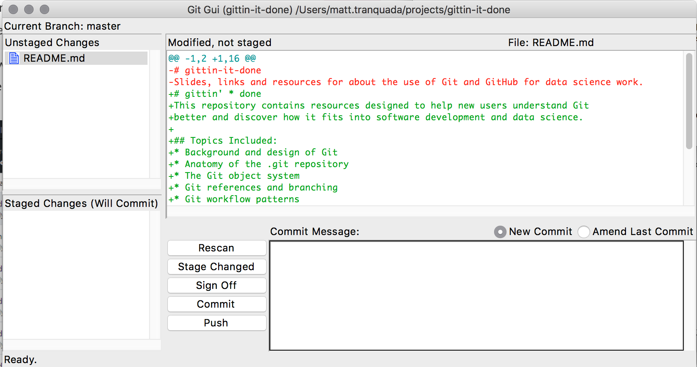
Customizing git: GUI options
If the command line is frustrating there are many options for adding GUIs to interact with Git
Git actually ships with a simple gui you can access using the git gui command from the command line
Popular GUI tools:
GitHub for Mac/Windows
TortoiseGit
Atlassian SourceTree
IDEs frequently also have extensions for Git support, though functionality may be limited or selective
The Git GUI interface
Atlassian’s SourceTree

Slide 32
2. Git Workflow Patterns
Or how to git along well with others

Slide 33
Basic: Centralized Workflow
Each developer synchronizes their work with a single, centralized repository that acts as a central hub for collaboration
This is functionally equivalent to a CVCS system like Subversion
Git does not allow users to overwrite each other
When multiple users push data at the same time, only the first push to reach the shared repo will succeed; other developers must fetch and merge the new remote changes before they can push their own
In Git, centralized workflows may still involve local repository copies because of its distributed design
The centralized workflow

Slide 34
Basic: Forking workflow
Also called a “multiple repository” workflow to contrast with the “centralized workflow”
Developers “fork”, or make their own reference copy, of the master repository and push changes to it rather than a central repository
Reduces merge issues posed by multiple developers pushing data to a single repo, but may make integrating pull requests and feature branches more complex
Often implemented in conjunction with hierarchical development roles including “integrators” who move source code changes between key repositories once it meets certain requirements
The forking workflow

Slide 35
BASIC: Feature Branch workflow
Feature branches are:
long-running (will be under sustained development for some time; think weeks/months/years)
may be merged into master multiple times
may have a hierarchy between them
Common uses for feature branches include:
isolating development code from production code
working on different subcomponents updated at different cadences
organizing work performed by different teams, etc.
The general pattern of feature branches
A 1:1 person-to-feature branch workflow

Slide 36
BASIC: Topic Branch Workflows
Topic branches are:
short-running (think weeks/days/even hours)
only merged back into other branches once
generally limited and specific in scope
Topic features are often applied to very small or experimental units of work, or even a specific code sprint
Because branches are cheap in Git, topic branches may be more common than in other VCS/SCM frameworks
A diagram of a repo with a master branch and three topic branches

Slide 37
BASIC: TRUNK-BASED DEVELOPMENT Workflow
Resurgent movement among some developers to focus on a single branch
Often associated with “eXtreme Programming” (XP), an agile software development process
Developers use short-lived branches (topic over feature) to experiment before merging back to the trunk
Aims to combat “merge hell” and facilitate Continuous Integration and Continuous Delivery practices
More info:
https://trunkbaseddevelopment.com/
http://www.extremeprogramming.org/
A diagram explaining Trunk-Based Development from trunkbaseddevlopment.com

Slide 38
ADVANCED: Integration Manager Workflow
A variant of the forking workflow; uses multiple repositories plus an integration manager role to coordinate and structure work
Developers maintain there own public and private repos, using the public repo to push finished work which the integrations manager pulls in changes from
Very common workflow used with hub-based tools like GitHub and GitLab
Allows contributors to work at their own pace while the maintainer of the main repository can pull in changes at any time from developer repos
The Integration manager pushes changes to the blessed repository
Developers clone the BLESSED repository to work from a private local repo
The contributors push their changes to their PUBLIC REPO
The contributor sends a PULL REQUEST MESSAGE to the integration manager
The Integration manager adds the contributor’s PUBLIC REPO as a remote and merges locally
The Integration manager pushes merged changes back to the blessed repository

Slide 39
ADVANCED: Dictator-Lieutenants WORKFLOW
A variant of the forking workflow; uses multiple repositories plus development roles to coordinate and structure work
Lieutenants act as integration managers for overseeing parts of the repository
This is the workflow used for the maintenance of the Linux kernel, and can commonly found in complex free and open source software projects
FOSS projects often have a governance structure that includes a BDFL, or Benevolent Dictator For Life, which is where the “dictator-lieutenants” metaphor originates
Best suited to huge projects with 100s of collaborators
Regular developers base their work off the master branch of the blessed repository where the Dictator pushes the reference directory
Lieutenants Merge the developers’ topic branches into the master branches they control
The Dictator merges the Lieutenants’ master branches into the DICTATOR’S master BRANCH
The DICTATOR PUSHES THEIR OWN master BRANCH to the blessed repository as the new reference directory

Slide 40
ADVANCED: GIT-Flow
Generally attributed to a blog post by Vincent Driessen
http://nvie.com/posts/a-successful-git-branching-model/
Extensions for Git: https://github.com/nvie/gitflow
Uses multiple standardized feature branches to organize typical development functions:
master (contains production/release code)
develop (the “integration branch”)
Supporting branches : supporting branches aid parallel development between team members and come in three types, each of which has specific rules
Feature branches
Release branches
Hotfix branches
Only the develop, release, and hotfix branches may be merged into the master branch

Slide 43
ADVANCED: GITHUB FLow
GitHub Flow is a simple trunk-based development workflow advocated by the developers behind GitHub
Code is put into production quickly supported by Continuous Integration and Continuous Delivery practices
If there is a problem with production code, the master branch can quickly be rolled back to a previous commit state
The GitHub Flow is partially facilitated by GitHub’s collaboration features
GitHub’s pull request and issue tracking APIs help developers collaborate on issues before merging rather than sorting through “merge hell”
Compared to Git-Flow, GitHub Flow is better suited to agile or iterative development cases with fast or continuous delivery cycles, but may be more difficult to manage for larger and more complex software projects

Slide 44
ADVANCED: GITHUB FLow
Create a branch
Add Commits
Open a Pull Request
Discuss and Review Code
Deploy for final testing in production
Merge to Master
The GitHub Flow diagram

Slide 45
WORKFLOW TIPS
Form follows function
Workflow structures seem to correlate closely with a project’s organizational structure, the expected delivery schedule, the scale of the code base, and the complexity of the components involved
Use rules and roles
Rule-based workflows or the use of integrator roles to move code between branches or repositories ensures code quality and makes it easier to resolve merge conflicts when they occur
Forks and branches are very similar (with a few key diffs)
Forks can minimize the amount of unnecessary code from other development branches you are storing locally if space is an issue, but you lose the ability to track progress on other branches using fetch etc.
In an open source setting, as a developer you are likely to have more control at the repo level than at the branch level (because repos can be read-only)

Slide 46
3. Advanced Git and Github Practices
Taking your repo to the next level

Slide 47
Commit MESSAGE BEST PRACTICES
Commit messages are very important to tracking the history of a project and understanding what work has been done
Many software projects need to produce a change log with each release, so a logical history of commit messages can bridge the gap
The canonical example of bad commit messages
Commits should be discrete and logical: one feature change = one commit
Commits are cheap in terms of resources, and more commits means more control if you need to revert the project state
The “official” standard for commits is to write in the present imperative, but styles vary
“Consider these messages as the instructions for what applying the commit will do”
Example: Add feature.py module to make viewing code simpler
Your first line should be under 50 characters, but you can add detail on additional lines if necessary
Commits can also be used for process automation in GitHub
Example: Including “Fixes #42” or “Close #42” will close issue #42 in the GitHub issue tracker

Slide 48
Tim Pope’s model Commit Message
Capitalized, short (50 chars or less) summary
More detailed explanatory text, if necessary. Wrap it to about 72 characters or so. In some contexts, the first line is treated as the subject of an email and the rest of the text as the body. The blank line separating the summary from the body is critical (unless you omit the body entirely); tools like rebase can get confused if you run the two together.
Write your commit message in the imperative: "Fix bug" and not "Fixed bug" or "Fixes bug." This convention matches up with commit messages generated by commands like git merge and git revert.
Further paragraphs come after blank lines.
Bullet points are okay, too
Typically a hyphen or asterisk is used for the bullet, followed by a single space, with blank lines in between, but conventions vary here
Use a hanging indent
https://tbaggery.com/2008/04/19/a-note-about-git-commit-messages.html

Slide 49
Chris Beam’s Seven Rules
Separate subject from body with a blank line
Limit the subject line to 50 characters
Capitalize the subject line
Do not end the subject line with a period
Use the imperative mood in the subject line
Wrap the body at 72 characters
Use the body to explain what and why vs. how
https://chris.beams.io/posts/git-commit/#seven-rules

Slide 50
UNDOING Things
Git tends to only add things when you make updates
Each commit (snapshot) only adds new things (blobs/trees) or references previously added objects – files that have been deleted can still exist as blobs from past commits

Slide 51
Merging vs. rebasing history

Slide 52
Resetting, checking out, and reverting

Slide 53
Git hooks

Slide 54
GIT REPO HOSTING
Git can track a repo on any Linux/Mac/Windows system, but repo hosting solutions can provide remote storage and access, along with a variety of project management capabilities and other convenient features
GitHub is the de facto standard by market share, but since Git is a completely distributed framework you can take your code wherever you want
Cloud Hosting Solutions
BitBucket (Atlassian)
CloudForge
Codebase
GitHub
Plan.io
Local Hosting Solutions
GitLab
Phabricator

Slide 55
GitHub Badges
Badges are used to indicate that repositories meet certain quality standards or include certain special features
Badges are normally small SVG images that are loaded from a remote site and can be embedded easily into your readme files

Slide 56
Continuous Integration Testing

Slide 57
4. GitHub Tips for data science
Making your repo more than a repo

Slide 58
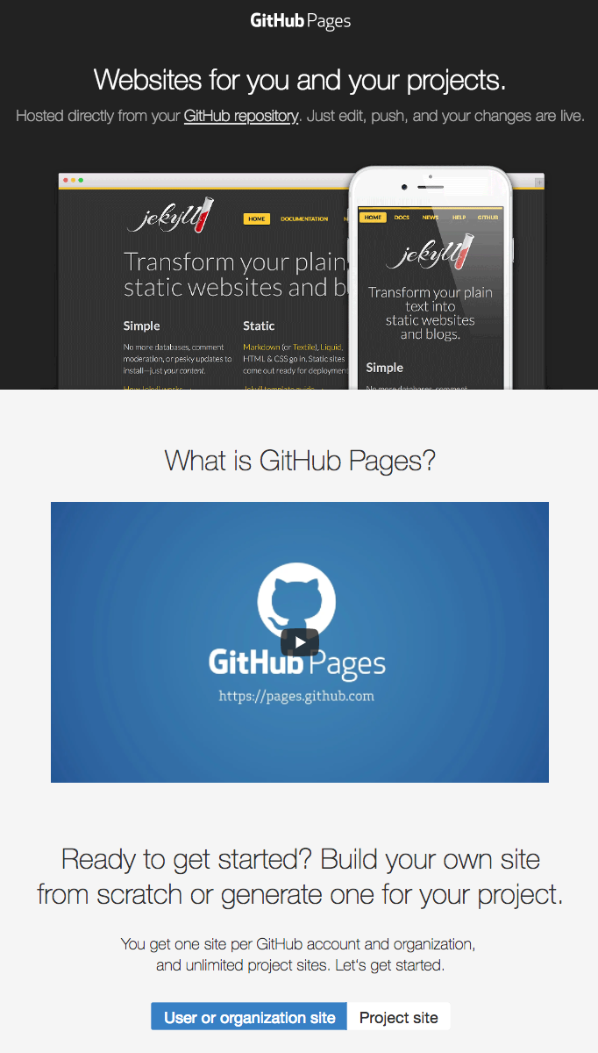
GitHub Pages https://pages.github.com/
Allows you to publish simple websites directly from GitHub
You can generate one site per GitHub account or organization, and unlimited project sites
Great for providing simple documentation or project information without having to worry about web hosting

Slide 59
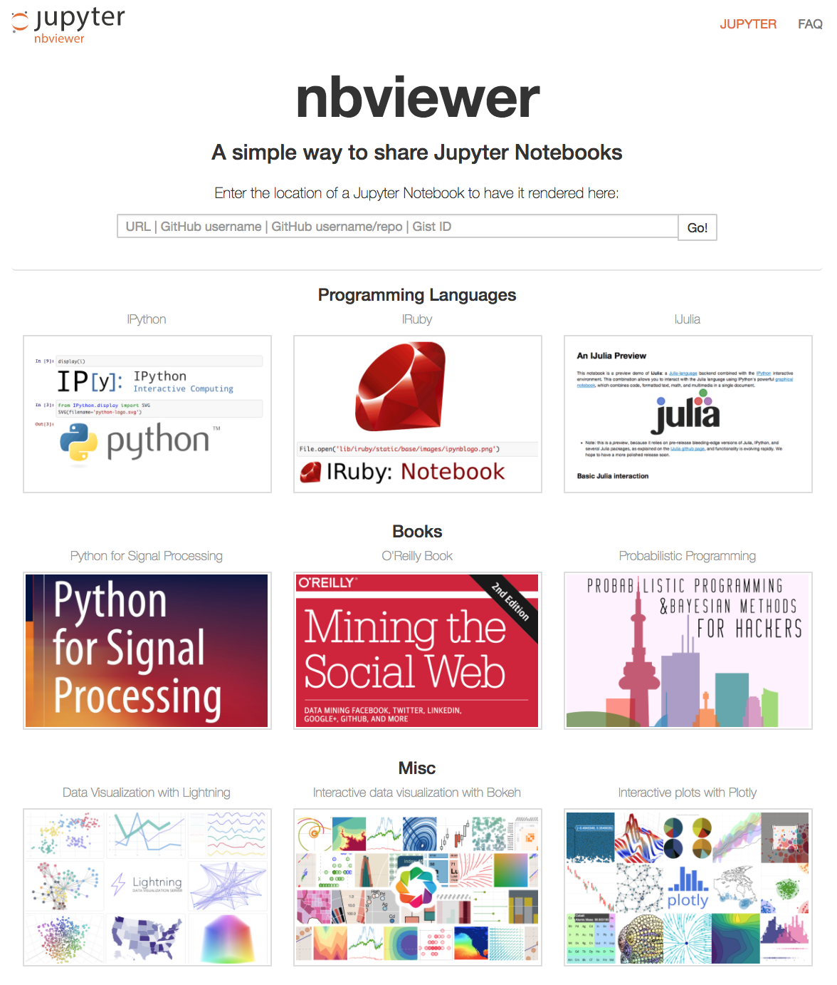
Jupyter NBViewer http://nbviewer.jupyter.org/
Free web service that allows rendering static html versions of publically-available Jupyter Notebooks (all you need is the link!)
Basically reads the json data from your Jupyter Notebook and renders the input and output fields just like your browser
However, there is no kernel running to execute code on the other end like in Jupyter Notebook
Can render notebooks hosted in your (or other people’s) GitHub repos

Slide 60
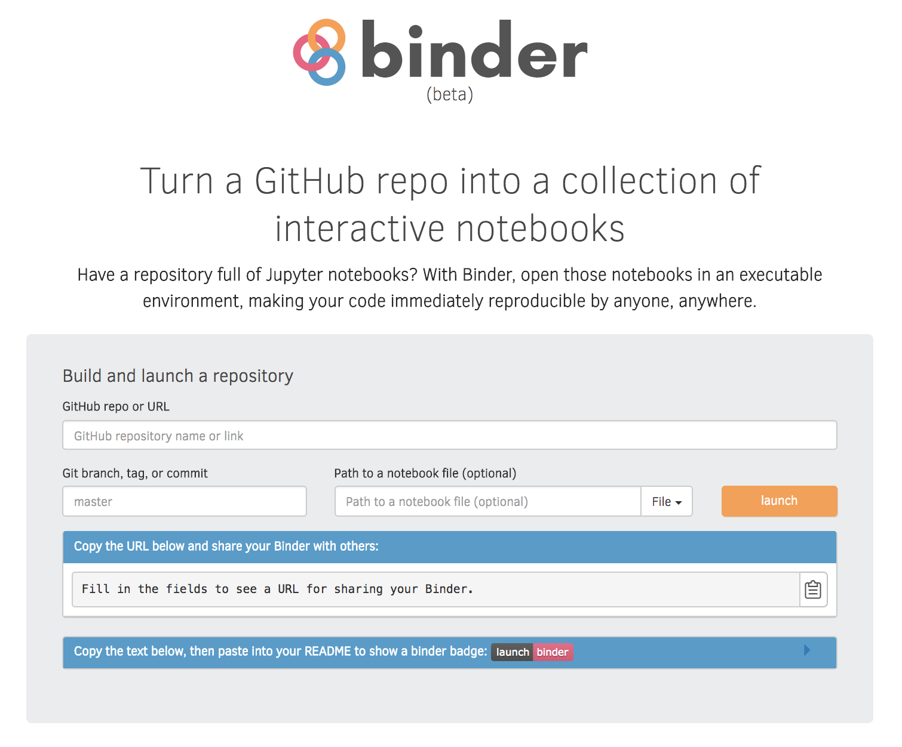
Binder (beta) https://mybinder.org/
Online tool that let’s you build a GitHub repo into a Docker image that can then run interactively online via JupyterHub
Includes a fancy Binder badge for GitHub you can include in your readme

Slide 61
5. Links and Resources
GIT and GITHUB References and documentation

Slide 62
Git DOCUMENTATION
API documentation: https://git-scm.com/docs
Pro Git, 2nd ed.:

Slide 63
GIT CHEATSHEETS
Official GitHub Git cheat sheet: https://services.github.com/on-demand/downloads/github-git-cheat-sheet.pdf
Interactive cheat sheet: http://ndpsoftware.com/git-cheatsheet.html
http://justinhileman.info/article/git-pretty/
https://github.com/hbons/git-cheat-sheet

Slide 64
Git concept visualizations and tutorials
https://www.atlassian.com/git/tutorials
https://learngitbranching.js.org/
https://onlywei.github.io/explain-git-with-d3/

Slide 65
GIT WORKFLOW INFO
Pro Git section on workflows: https://git-scm.com/book/en/v2/Distributed-Git-Distributed-Workflows#ch05-distributed-git
Vincent Driessen’s blog post on Git-Flow: http://scottchacon.com/2011/08/31/github-flow.html
Extensions for implementing Git-Flow in Git: https://github.com/nvie/gitflow
Atlassian’s guide to Git-Flow: https://www.atlassian.com/git/tutorials/comparing-workflows/gitflow-workflow
GitHub Flow guide: https://guides.github.com/introduction/flow/index.html
Scott Chacon’s blog post on GitHub Flow: http://scottchacon.com/2011/08/31/github-flow.html

Slide 66
Git Commit Messages
“How to Write a Git Commit Message”: https://chris.beams.io/posts/git-commit/#seven-rules
“5 Useful Tips for a Better Commit Message”: https://robots.thoughtbot.com/5-useful-tips-for-a-better-commit-message
“A Note About Git Commit Messages”: https://tbaggery.com/2008/04/19/a-note-about-git-commit-messages.html
“The imperative style”: https://dpb.bitbucket.io/the-imperative-style-in-commits-and-docstrings.html
GitHub help article on closing issues with commits: https://help.github.com/articles/closing-issues-using-keywords/

Slide 67
GITHUB Documentation

Slide 68
Cool GitHub REPO Examples

